Slide 1
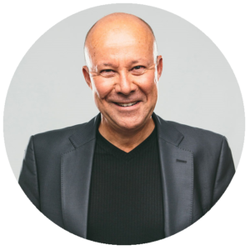
John Hudson | Senior Advertising Consultant | 306.596.3980
Includes:
Exclusive lunch with Gormley at Golf’s Steak House
Signed copy of his best selling Book
Studio Experience and tour of Rawlco Radio
About John Gormley…
Lawyer and author, John Gormley is a former Member of Parliament whose radio show has become an important part of life in Saskatchewan. John has been a show host on 650 CKOM and 980 CJME for over 20 years, covering the big topics and conversations, both local and international.
John is a regular convention speaker, entertaining audiences on topics ranging from politics to pop culture. At the University of Saskatchewan, he has taught political science students and has been an adjunct faculty member in the College of Law.
John has written two books. His first, “Left Out: Saskatchewan’s NDP and the Relentless Pursuit of Mediocrity” is a Canadian bestseller. His second book “The Gormley Papers: I’m Right and You Know It” is a compilation of newspaper columns touching on everything from current issues to living a better life.
Appointed Queens Counsel, John has also been on Saskatchewan Business Magazine’s list of the province’s 10 Most Influential People.
Donated by 980 CJME
To claim prize, contact John Hudson 306-596-3980

